Slide 1
US Government State wise financial data analysis

Slide 2
About Dataset
This dataset contains financial information of U.S. state governments across multiple years. It includes detailed records on revenue, expenditure, capital outlay, debt, taxes, education, healthcare, welfare, transportation, insurance trust revenue, and more. The data allows for in-depth analysis of government financial health, budgeting priorities, and economic patterns at the state level.
Key Features:
Covers multiple years and all U.S. states.
Includes breakdowns across sectors like education, healthcare, natural resources, welfare, highways, and police protection.
Useful for financial performance analysis, revenue-expenditure comparison, and policy planning insights.

Slide 3
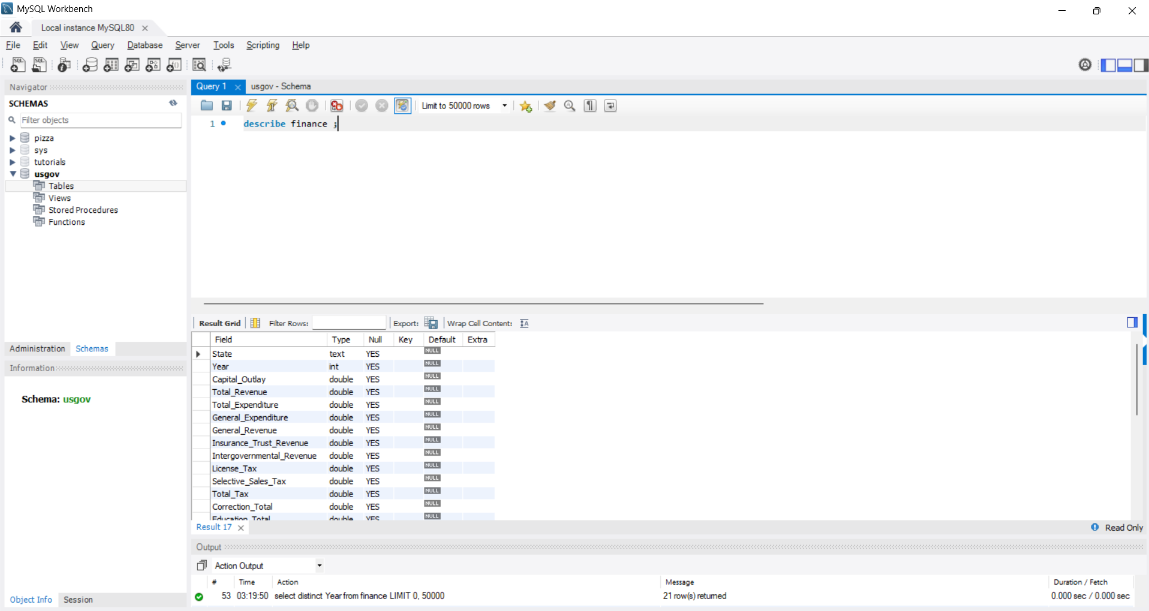
Describe table

Slide 4
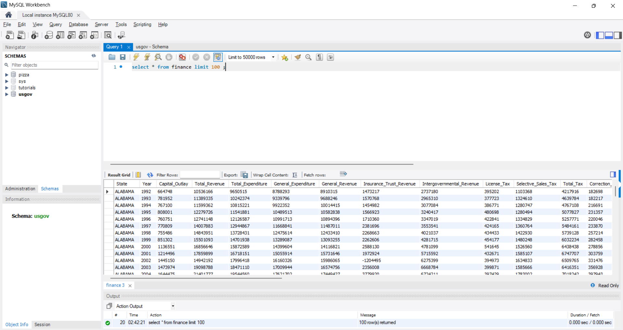
Sample Dataset

Slide 5


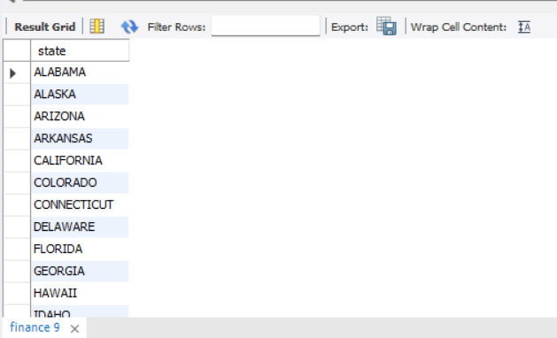
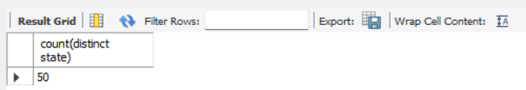
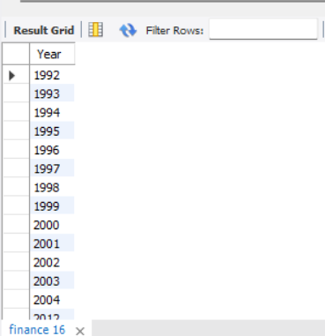
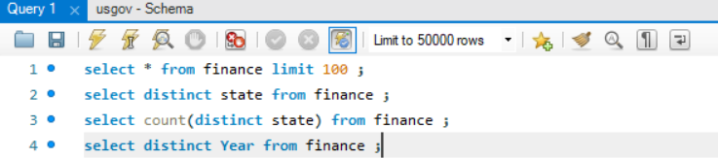
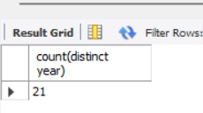
Unique States & Unique Years
Distinct year count:

Slide 6
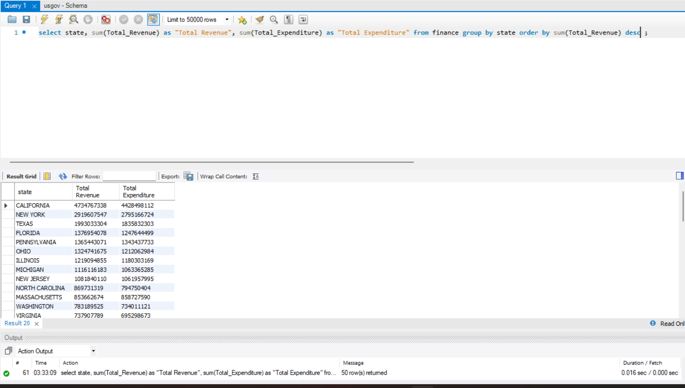
Total Revenue Vs Total Expenditure

Slide 7
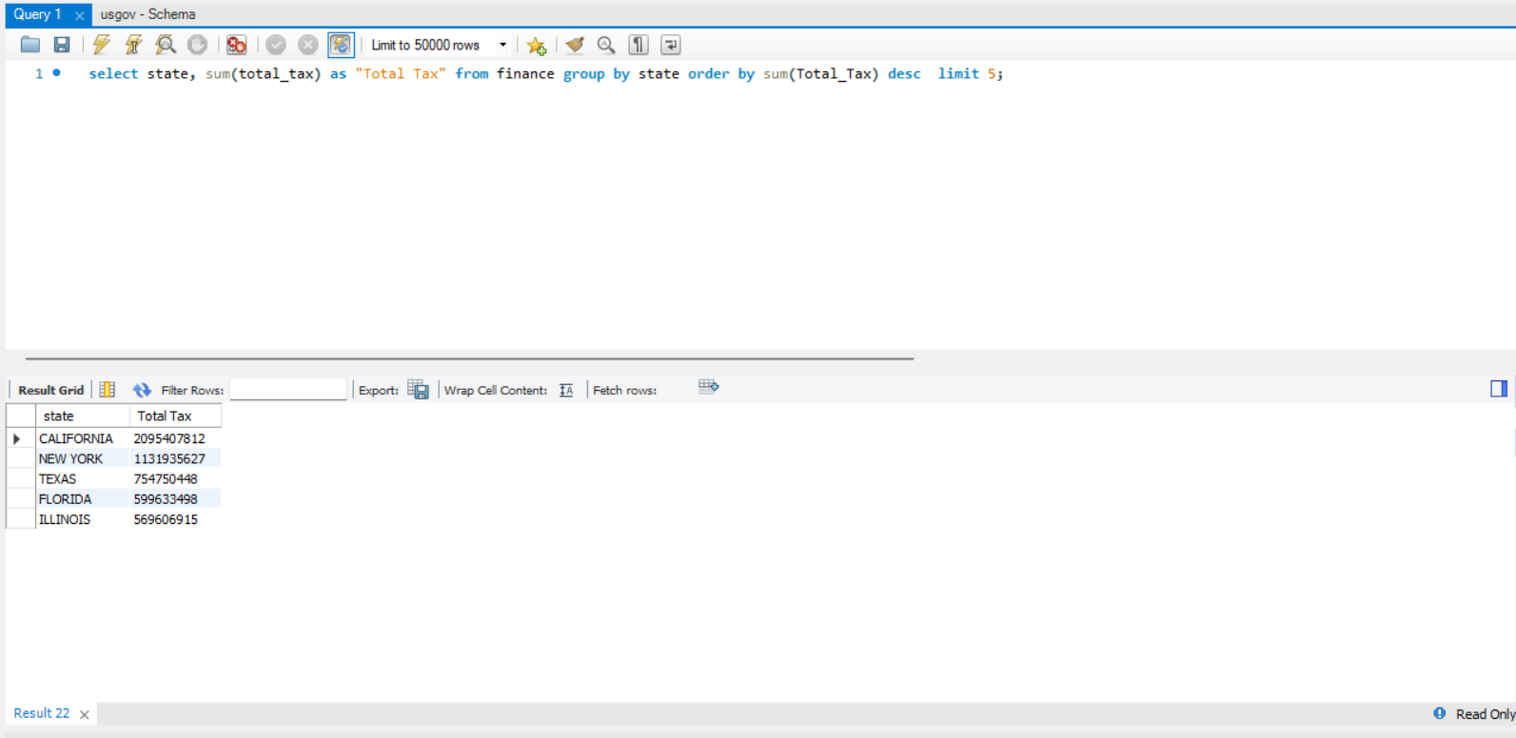
Top five states with highest Total Tax

Slide 8
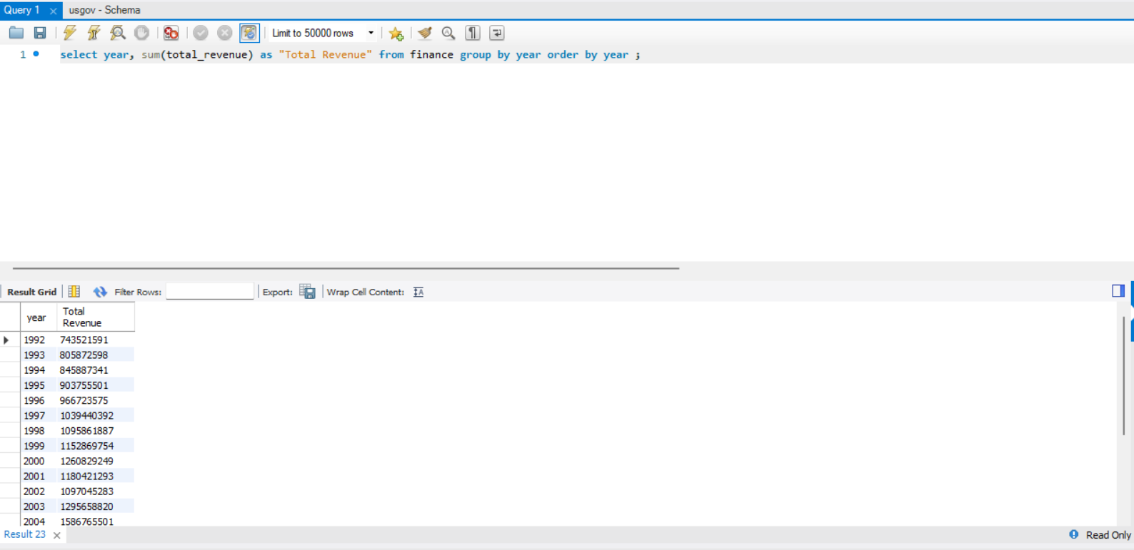
Year wise revenue growth

Slide 9
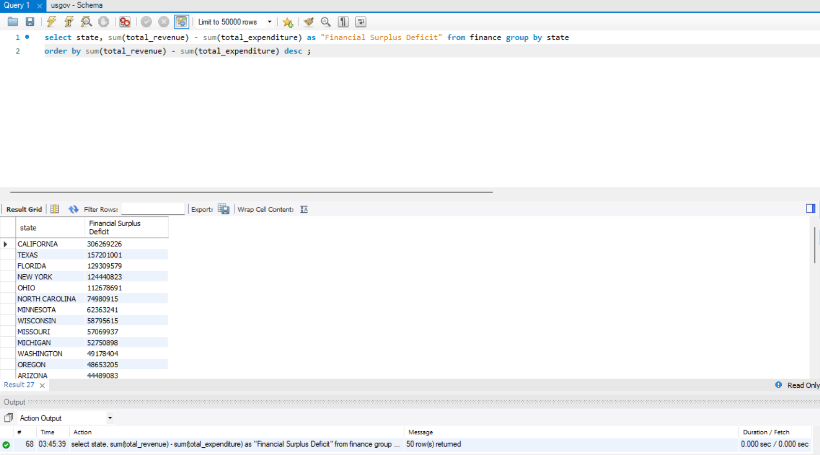
Financial Surplus or Deficit

Slide 10
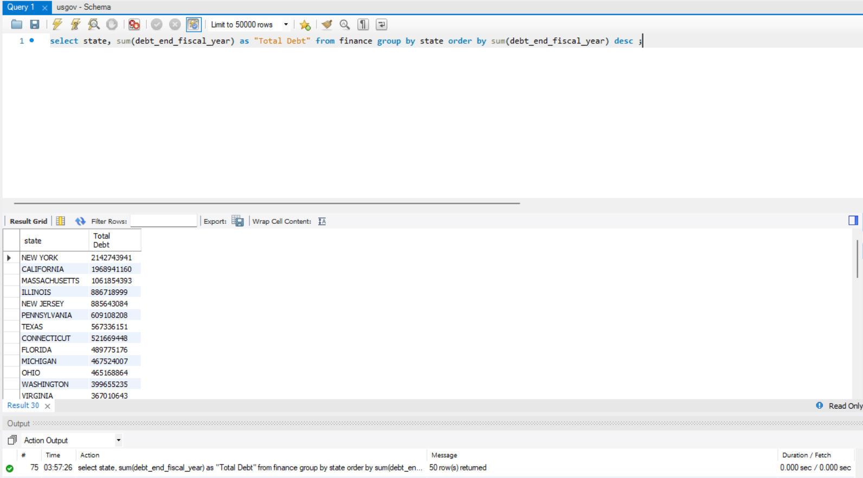
Total Debt by state

Slide 11
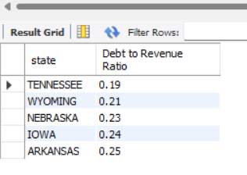
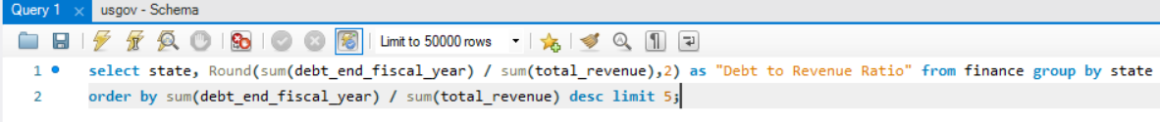
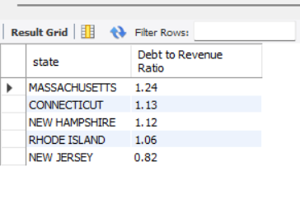
Debt to revenue ratio best and worst five
Best five:
Worst five:

